Slide 1
HTTP and CDNs
Lecture 15 (Applications 2)
CS 168, Summer 2025 @ UC Berkeley
Slides credit: Sylvia Ratnasamy, Rob Shakir, Peyrin Kao, Iuniana Oprescu
Notes:
Slides template credit: Josh Hug, Lisa Yan

Slide 2
HTTP Specification
HTTP
Protocol Specification
Examples
Speeding Up HTTP
Content Delivery Networks
Deployment
Directing Clients to Caches
Newer HTTP Versions
Lecture 15, CS 168, Summer 2025

Slide 3
Brief History of HTTP
Development initiated by Tim Berners-Lee at CERN in 1989.
1991: Initial specification, HTTP/0.9, drafted.
1996: Standardized as HTTP/1.0.
1997: Updated to HTTP/1.1.
We'll use this version unless otherwise specified.
Driven by a need to share information between scientists.
Needed a mechanism to transfer hypertext pages, with links to other pages.
Resulting protocol: HyperText Transfer Protocol.
You can still view the first website ever made.
Notes:
load different pages so for example if you think about the early internet people would load files
1:04
and send like raw text files between each other over the network but you could imagine if someone gives you a
1:10
text file maybe that file should have a link to a different file or it could have different links to all these
1:15
different files and the files should somehow be able to link to each other so that's where HTTP comes in the original
1:22
Vision was to be able to have all these different pages and that could link to each other

Slide 4
HTTP: Basics
HTTP is a client-server protocol.
One user is the client (e.g. your web browser, your terminal).
One user is the server (e.g. the website).
HTTP runs over TCP.
Client and server run a TCP handshake, and send data over the bytestream.
No need to worry about packets being reordered, dropped, etc.
Server listens for HTTP on well-known port 80. (A later secure version uses 443.)
HTTP is a request-response protocol.
Client sends one request, and receives exactly one response.
Client (random port)
TCP bytestream
Server (port 80)
Notes:
Mention HTTP is layer 7
so you can pick any random Port that you want to start the connection and then the server will
4:22
send data back to your randomly chosen port or room number by contrast the
4:28
server they do need a constant port number because if you think about public buildings like soda Hall well the room
4:35
numbers on the classrooms those have to be constant you can't just go to soda Hall and start shuffling around the room

Slide 5
HTTP Requests
The request syntax is in human-readable plaintext (can be typed by a human).
Version: What HTTP version we're using.
URL: The resource we want to interact with.
Intuition: The filepath of a file on some remote server.
Method: What we want to do with that resource.
GET: Send me this resource. Originally, this was the only method.
POST: Send data to the server (e.g. user submits a form).
Other methods for manipulating content on the server, not just retrieving it:
PUT, CONNECT, DELETE, OPTIONS, PATCH, TRACE, etc.
GET /projects/project1.html HTTP/1.1 \r\n
Method
URL
version
ends with a newline
Notes:
his is how you break down what HTT TP requests look like so we'll start with requests and then we'll do
6:03
responses so the thing I find kind of interesting about HTTP is that the syntax is actually the human readable so
6:09
in other words the data that we're sending it's literally these English characters that you're sending over TCP
6:16
so you start the TCP connection and once you have that pipe the letters that you feed into the pipe it's literally these
6:23
English characters a human can actually read this you can even type this so if you're really old school you could open
6:30
a terminal start an HTTP connection and you could literally type the characters of this request and the server will
6:37
understand what you're saying

Slide 6
HTTP Responses
Version: What HTTP version we're using.
Status code: A number, telling us what happened with the request.
Description: A description of the status code.
Content: The resource the user requested!
HTTP/1.1 200 OK <html>Project 1 Spec...</html>
version
status code
description
content
Notes:
Status code 200 is OK
Hypertext Markup Language (HTML)

Slide 7
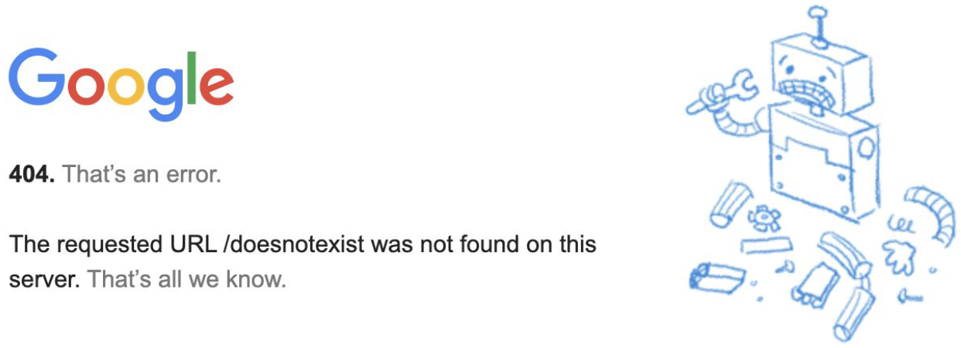
HTTP Responses – Status Codes
Status codes are used by the server to propagate information about the result of the request to the client.
Codes are classified into various categories, according to numeric value.
100s: Informational responses.
200s: Successful responses.
300s: Redirection messages.
400s: Client error.
500s: Server error.

Slide 8
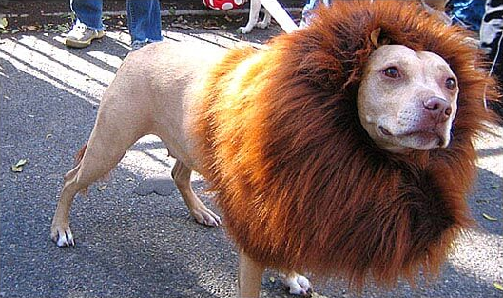
HTTP Responses – Status Codes
200s: Successful responses.
200 OK: Request was successful.
Definition of success depends on the method in the request (e.g. GET, POST).
201 Created: Request succeeded, and some new resource was created.
Seen generally in POST or PUT requests.
The HTTP status dog for 203 Non-Authoritative Information.

Slide 9
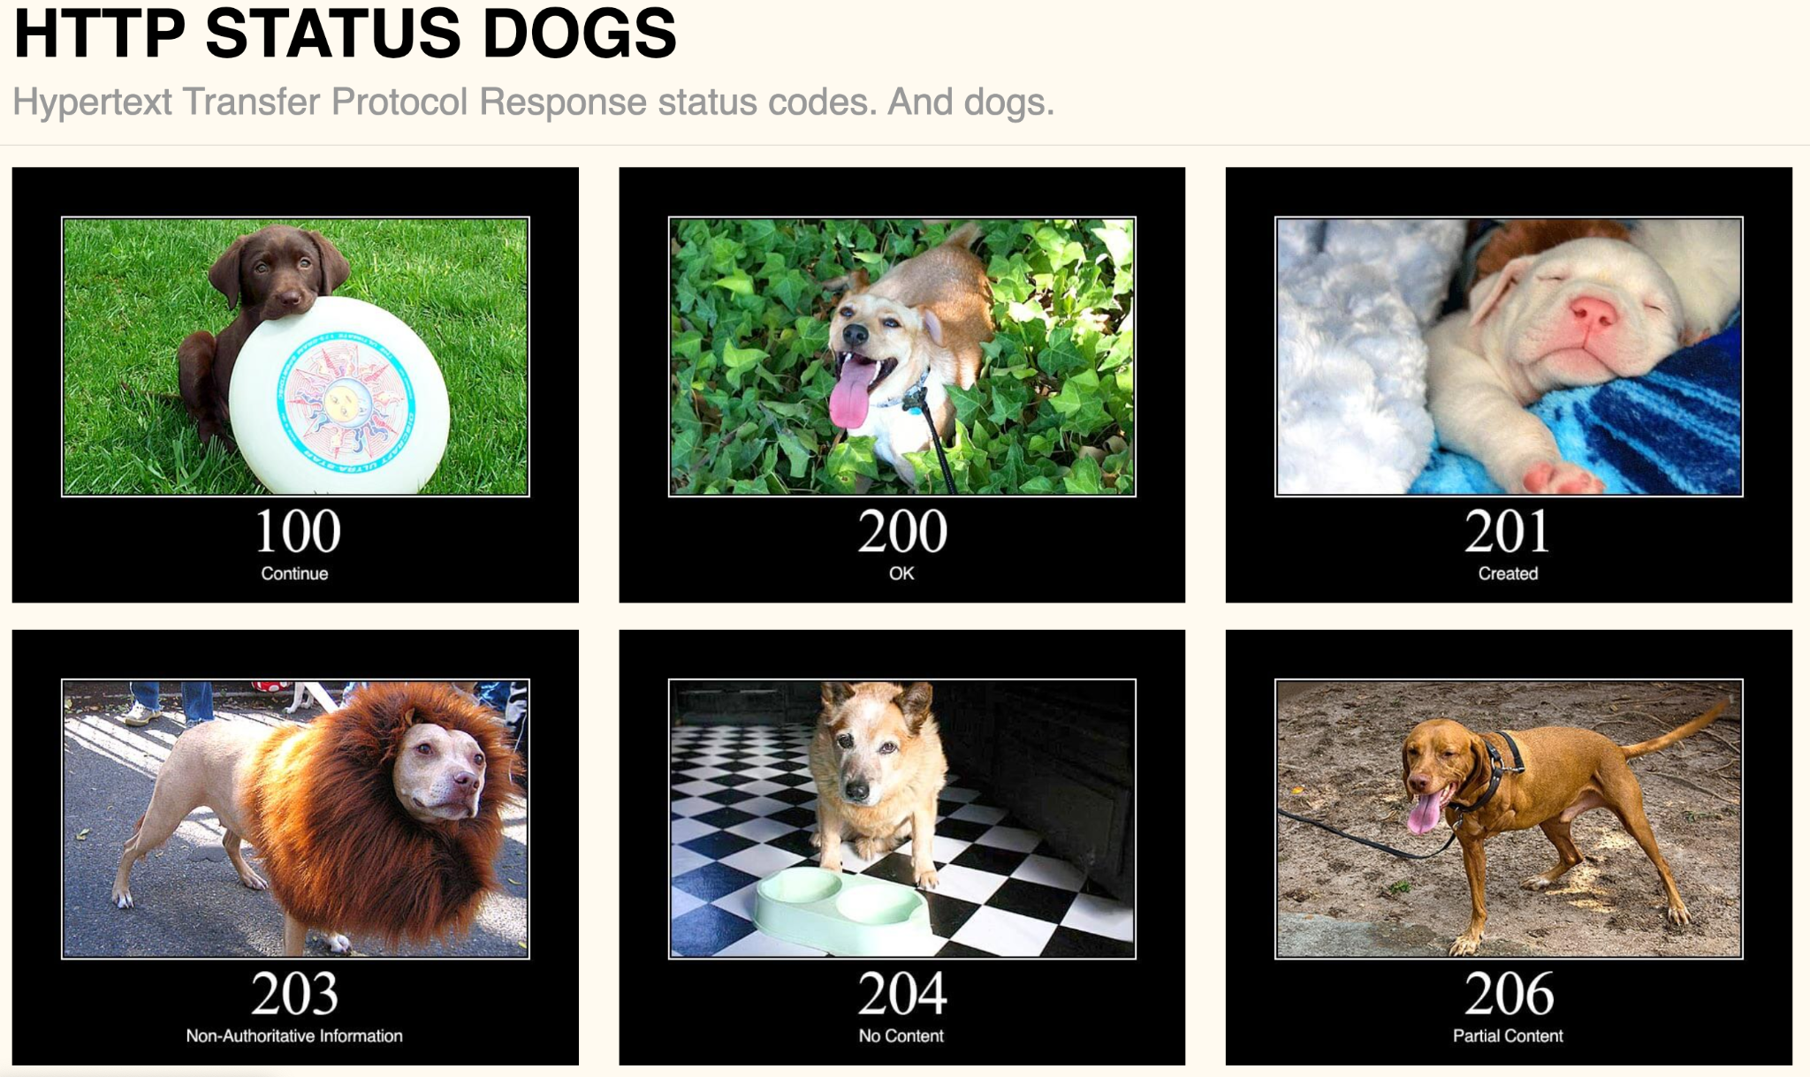
HTTP Responses – Status Codes
The HTTP status dogs

Slide 10
HTTP Responses – Status Codes
300s: Redirection messages.
Used when a server is telling a client they should go and look for the resource (specified by the URL) somewhere else.
301 Moved Permanently.
302 Found: Moved temporarily.
Response contains extra context about where the resource moved.
Location: https://some.other.site/newpage.html
Encoded in a header (more on this soon).
Status codes let the client determine future behavior.
Example: 301 means, always go to the new location.
Example: 302 means, come back here to check again in the future.

Slide 11
HTTP Responses – Status Codes
400s: Client error responses.
401 Unauthorized: You need to authenticate (e.g. log in) to access this content.
403 Forbidden: You are authenticated (server knows your identity), but access is still forbidden.
404 File Not Found: You are requesting a file that doesn't exist.
500s: Server error responses.
500 Internal Server Error: Server hit an error processing your request.
503 Service Unavailable: Server cannot respond at the current time.
Status codes let the client determine future behavior.
Example: 401 means, ask the user to log in.
Example: 403 means, show an error message.
Notes:
400 - client screwed up
500 - server screwed up

Slide 12
HTTP Responses – Status Codes
Sometimes, which status code we should use is ambiguous.
Example: Request the Google homepage with HTTP/0.9.
Maybe Google should respond with: 505 HTTP Version Not Supported.
But Google actually responds with: 400 Bad Request.
Usually, the category of error is the most important.
In the example: 400 or 500 = error.
Goal is to elicit the correct behavior from the client.

Slide 13
HTTP Headers
Requests and responses can contain additional metadata in the form of headers.
Headers aren't mandatory (though server/client might expect a header and error).
Some headers are optional information.
User-Agent: What program (e.g. Firefox, Chrome) the client is using.
Could result in different processing of the request.
Some headers are critical information.
Content-Type: File type of the response. (e.g. HTML, JPEG image, MP4 video...)

Slide 14
HTTP Header Classes – Request
Headers can be classified into three types.
Request headers pass information about the client to the server.
Accept: What file type the client is expecting in the response. Examples:
Accept: text/html
Accept: application/json
Accept: image/*
Host: If a server is hosting multiple websites, identifies which website the client is aiming to access.
Host: google.com:80
Referer: How the client triggered this request (e.g. clicking a link on Facebook).
User-Agent: What program (e.g. Firefox, Chrome) the client is using.
"Referer" was misspelled in the original spec. Oops.
Notes:
Host - google or youtube if the server hosts both

Slide 15
HTTP Header Classes – Response and Representation
Response headers are in the response, but not directly related to the content.
Date: When the server generated the response.
Location: In 300 redirect responses, where the content moved to.
Server: What software the server used to generate the response.
Representation headers are used in both requests and responses to describe how the content is represented.
Content-Type: File type of the response. (e.g. HTML, JPEG image, MP4 video...)
Content-Encoding: How the response is encoded into bits.
Content-Encoding: gzip says the contents were compressed.
Notes:
Redirected case location header used to point to where the content actually is

Slide 16
HTTP Examples
HTTP
Protocol Specification
Examples
Speeding Up HTTP
Content Delivery Networks
Deployment
Directing Clients to Caches
Newer HTTP Versions
Lecture 15, CS 168, Summer 2025

Slide 17
HTTP in Terminal
$ telnet google.com 80
Trying 2607:f8b0:4005:802::200e...
Connected to google.com.
Escape character is '^]'.
GET / HTTP/1.1
User-Agent: robjs
HTTP is a text-based protocol, so we can connect to the Google server, type requests, and read responses, all in the terminal.
Using port 80 for HTTP.
Request: Get homepage, using HTTP version 1.1.
Adding a header to tell the server what type of client I'm using.

Slide 18
HTTP in Terminal
$ telnet google.com 80
Trying 2607:f8b0:4005:802::200e...
Connected to google.com.
Escape character is '^]'.
GET / HTTP/1.1
User-Agent: robjs
HTTP/1.1 200 OK
Date: Sat, 16 Mar 2024 18:33:08 GMT
Content-Type: text/html; charset=ISO-8859-1
<!doctype html><html lang="en"><head><meta content="Search the world's information, including webpages, images, videos and more. Google has many special features to help you find exactly what you're looking for." name="description">...
Response starts with status code: 200 OK.
Headers tell us the response date, file type (HTML), and encoding (e.g. ASCII).
The page we requested. (Would look nicer in a browser.)

Slide 19
HTTP Examples
Note: We need a URL in all requests (even POST requests).
The URL tells the server how to parse the information in the body of the request.
Example: POST /send-money and POST /request-money do different things.
Note: The HTTP request can contain data.
POST and PUT requests might contain data.
GET requests probably don't contain data.
Note: This response doesn't have any content.
The Location header redirects the user to the success.html page.
Request
Response
POST /send-money HTTP/1.1
User-Agent: robjs
target=alice&amount=10
HTTP/1.1 201 Created
Location: success.html

Slide 20
HTTP Examples
The request has data (PUT a file on the server).
The response does not have data.
The Content-Location header says that the file we uploaded is stored at newfile.html.
Request
Response
PUT /newfile.html HTTP/1.1
User-Agent: robjs
<p>Some File</p>
HTTP/1.1 201 Created
Content-Location: newfile.html
Notes:
here I've decided I would like to put a file at the location New file. HTML and
26:00
here's the text of the file and the response says 201 it's created and it lives at new file.HTML and it doesn't
26:07
have any further data so there's another example of the request having data but the response not having data and that's
26:14
totally fine too

Slide 21
Speeding Up HTTP
HTTP
Protocol Specification
Examples
Speeding Up HTTP
Content Delivery Networks
Deployment
Directing Clients to Caches
Newer HTTP Versions
Lecture 15, CS 168, Summer 2025

Slide 22
Multiple HTTP Requests
Loading a single website can require multiple HTTP requests.
One request for the HTML (text/formatting) of the page.
Separate requests for every picture.
Separate requests for scripts to make the page interactive.
Naive approach: Separate TCP connection for each request.
We have to do a 3-way handshake for every request.
Client (random port)
Server (port 80)
GET /googlelogo.png HTTP/1.1
GET /googleicon.png HTTP/1.1

Slide 23
Multiple HTTP Requests – Pipelining
Smarter approach: Allow multiple requests to be pipelined over the same TCP connection.
Trade-off: The server must maintain more open connections.
Client (random port)
Server (port 80)
GET /googlelogo.png HTTP/1.1
GET /googleicon.png HTTP/1.1

Slide 24
HTTP Cache Types
Optimization: Cache data to avoid sending duplicate requests for the same content.
Naive approach: Every request goes to to the origin server.
Origin server: The server with the true (not cached) version of the content.
There are 3 types of caches: Private, Proxy, Managed.
In this diagram, 3 clients each request the same resource twice.
Client A
Origin Server
Client B
= first request
= second request
Client C

Slide 25
HTTP Cache Types
Private caches are tied to a specific end client (e.g. in a user's browser).
When a user requests something for the second time, they can use the cache.
In this diagram, 3 clients each request the same resource twice.
Client A
Origin Server
Client B
= first request
= second request
Client C

Slide 26
HTTP Cache Types
Proxy caches are in the network (not end host).
The first client's first request goes to the origin server.
All subsequent requests can be served by the proxy cache.
Proxy caches are operated by a third party (not the client or server).
Problem: Clients need to be redirected to the proxy cache somehow.
DNS resolver could lie and say, "server's IP address is [proxy cache address]."
Proxy Cache
In this diagram, 3 clients each request the same resource twice.
Client A
Origin Server
Client B
= first request
= second request
Client C

Slide 27
HTTP Cache Types
Managed caches are in the network (just like proxy caches).
Managed caches are operated by the server (but cache server ≠ origin server).
Gives the server more control. Proxy cache might serve outdated/incorrect data.
Server can redirect client to cache, because server knows about the caches.
In the HTML page: "Load the logo image from cache.google.com."
There can be multiple proxy/managed caches in the network.
Managed Cache
In this diagram, 3 clients each request the same resource twice.
Client A
Origin Server
Client B
Managed Cache
= first request
= second request
Client C

Slide 28
Implementing Caching – Static vs. Dynamic Content
HTTP resources can be static or dynamic.
Static: Stays the same for a long time. (e.g. Google logo image.)
Dynamic: Generated on-demand for every request. (e.g. Search results.)
The server needs to tell everybody whether data can be cached, and if so, for how long.
We can use HTTP headers!
Expires header tells us when the content can be cached until.
Used in HTTP/1.0, obsoleted in HTTP/1.1.
Servers can't enforce that clients and caches actually obey the header.
The header is more of a request to cache than a contract.
HTTP/1.0 200 OK
Date: Sat, 16 Mar 2024 19:40:24 GMT
Expires: Sun, 17 Mar 2024 19:40:24 GMT
The data in this response can be cached for 24 hours!

Slide 29
Implementing Caching – Cache-Control Header
The Cache-Control header lets the server give more details on how to cache the data.
Cache-Control: private, max-age=86400
Store in private caches for 24 hours.
Useful for responses that are different per user (private cache only).
Cache-Control: no-store
This content cannot be cached.
More complex policies are possible.
Example: Use the HEAD request method to re-request the header only and re-validate the data before using cache.
HTTP/1.1 200 OK
Date: Sat, 16 Mar 2024 19:40:24 GMT
Expires: Sun, 16 Mar 2024 19:40:24 GMT
Cache-Control: private, max-age=31536000
Servers could include both Expires (1.0) and Cache-Control (1.1) headers for compatibility.
1.1 client might ignore 1.0 header (and vice-versa).
Notes:
Your icon, personalized content on youtube

Slide 30
Benefits of Caching
Caching benefits everybody.
Client can load pages faster.
With private caches, client saves time on subsequent accesses.
With proxy/managed caches, client gets data from a closer source.
Closer sources = lower RTT = higher TCP throughput.
Less network bandwidth is needed.
Proxy caches are useful when there's low bandwidth out of a network.
Reduces load on origin server.
Conveniently, the larger objects are static.
Go to the origin server for dynamic content (e.g. small HTML page).
Use a cache for static content (e.g. images, videos).
Notes:
Infrastructure needs are decreased due to lower bandwidth

Slide 31
Content Delivery Networks
HTTP
Protocol Specification
Examples
Speeding Up HTTP
Content Delivery Networks
Deployment
Directing Clients to Caches
Newer HTTP Versions
Lecture 15, CS 168, Summer 2025

Slide 32
Using Caches for Content Delivery
How can application providers use caching to improve load time for users?
Private caches are only useful if the same user accesses the same content repeatedly.
Proxy caches aren't managed by the server.
Need some changes to tell the client about the caches (e.g. DNS trick).
Proxy cache might not obey the rules in the header.
Managed caches are the best choice.
Controlled by the application provider.
Can be placed "close" to end users.
Application provider can redirect users to the caches.

Slide 33
Content Delivery Networks
Content Delivery Networks (CDNs): Deployments of servers that can serve content (HTTP resources).
Servers can be placed "close" to end users.
Geographically.
From a network perspective. (e.g. number of hops)
Benefits of CDNs:
Higher performance for users.
Low-latency, high-throughput access to nearby server.
Significant reductions in the bandwidth needed in the network.
Reduces scaling needed for server infrastructure.
Adding more servers is easier than building one huge server.
Provides better redundancy. If a server goes down, use another one.

Slide 34
Deploying CDNs
Without CDNs, every request reaches the origin server.
Maximum latency → lowest performance.
Maximum amount of "backbone" network traversed → highest cost to build.
Scale must be supported on the origin server.
WAN
Peering
Peering
WAN
Datacenter
Client
Origin Server
Client
Client
Client

Slide 35
Deploying CDNs
Application provider could deploy CDNs in its own network.
Smaller servers at the "edge" of the application provider's networks.
Reduces the volume of backbone traffic for the application provider.
Reduces scale per deployment.
WAN
Peering
Peering
WAN
Datacenter
Client
CDN
Origin Server
Client
Client
CDN
Client

Slide 36
Deploying CDNs
Caching can be pushed "deeper" into the network.
Deploying CDNs in the ISP's network improves performance and reduces cost.
ISP reduces their backbone network cost.
Less peering infrastructure needed.
WAN
Peering
Peering
WAN
Datacenter
Client
CDN
Origin Server
Client
Client
CDN
Client
Notes:
Verizon - google

Slide 37
Deploying CDNs
Deployment depth is limited by efficiency.
Need many users accessing the same content to justify the cost of the CDN.
Cost-benefit trade-off between:
Cost of building a CDN.
Cost savings from building less network capacity.
Example: Deploying a CDN in every user's home is probably not worth the cost.
WAN
Peering
Peering
WAN
Datacenter
Client
CDN
Origin Server
Client
Client
CDN
Client

Slide 38
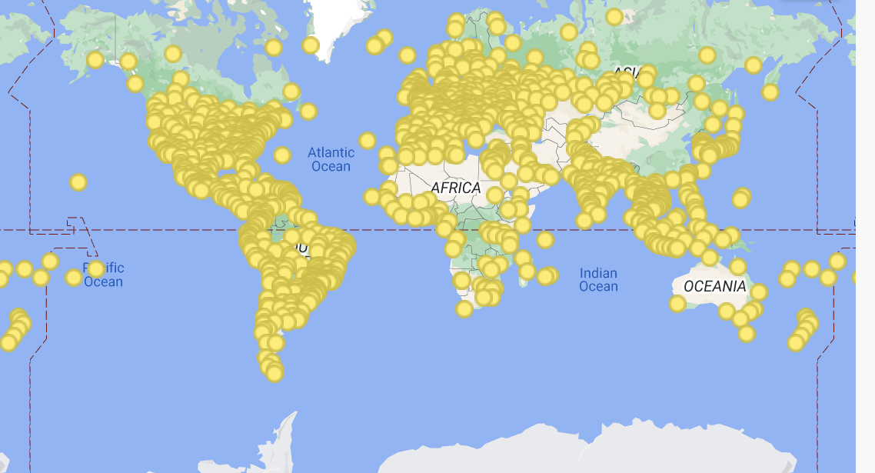
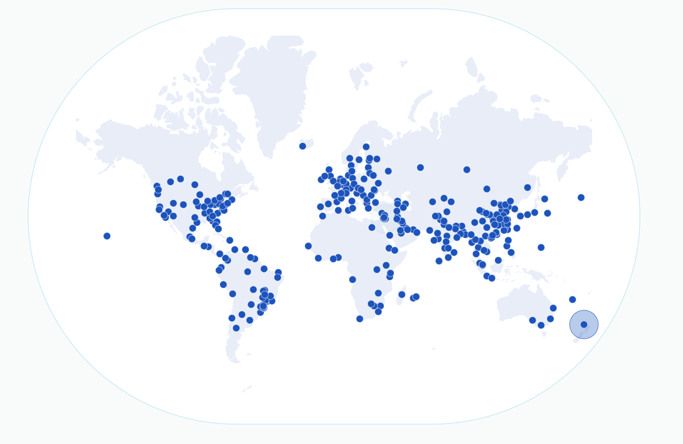
Large Global CDNs
Large application providers host their own CDNs.
Netflix, Google, Amazon, Facebook.
CDN providers can host your service on their infrastructure for a fee.
Cloudflare, Akamai, Edgio.
Useful for smaller application providers.
Deployments either in their own networks, or directly into ISP networks.
Notes:
https://peering.google.com/#/infrastructure
https://www.cloudflare.com/network/

Slide 39
CDNs in ISP Networks
ISP companies often have their own content to serve.
Example: Video-on-demand, or live TV, as part of TV+Internet bundles.
CDN server infrastructure is also deployed by these ISPs.
Often a need for both third-party caches and the ISP's own infrastructure.
Sandvine report (2023):
15% of all Internet traffic is Netflix.
11.4% is YouTube.
4.5% is Disney+.
Deploying caches can mean reducing ~25% of network capacity!

Slide 40
Caching Server Deployments
CDN servers are highly optimized for content delivery and storage.
Flash appliance focus areas
2U for rack efficiency (no deeper than 29 inches)
Enough low cost NAND to reach 24GB/s of throughput (<0.3 DWPD)
Connect at up to 2X100G LAG
2 and 4 post racking
AC or DC power
Single processor
Storage appliance focus areas
Large storage capacity
2U for rack efficiency (no deeper than 29 inches)
Enough low cost NAND to reach 10GB/s of throughput (<0.3 DWPD)
Network flexibility to connect at 6x100 LAG or up to 2x100GE
2 and 4 post racking
AC or DC power
Single processor
Example of Netflix server specs (you don't need to understand these).
Notes:
https://openconnect.netflix.com/en/appliances/

Slide 41
CDN Commercial Model
CDNs are mutually beneficial!
Content provider gets better performance.
Better performance = more customers for both application and ISP.
ISP gets lower bandwidth costs.
Cooperative commercial model:
Content provider provides the servers for free.
ISP hosts the servers for free.
In some cases, commercial negotiations are required.
ISP and provider costs might not be equal as we get "deeper" into the network.
Becomes more difficult as there are more caching providers.

Slide 42
Commercial Challenges – Fragmentation
Cache deployment makes sense if there are small numbers of large content providers.
There's a long tail of smaller content providers.
Sandvine (2023): 4.5% is Disney+, 2.8% is Amazon Prime.
Idea: Can we have shared caching infrastructure?
CDN InterConnect (CDNI) – IETF
OpenCaching
Shared infrastructure is challenging!
Who ensures quality?
How are resources shared?
Bandwidth
Time
Bandwidth
Time

Slide 43
Directing Clients to Caches
HTTP
Protocol Specification
Examples
Speeding Up HTTP
Content Delivery Networks
Deployment
Directing Clients to Caches
Newer HTTP Versions
Lecture 15, CS 168, Summer 2025

Slide 44
Directing Clients to Caches
Recall our CDN model:
Go to the origin server for dynamic content (e.g. small HTML page).
Origin server directs the user to a cache for static content (e.g. images, videos).
If there are many CDN servers, which one should the server direct the user to?
Three approaches:
Anycast.
DNS-based load balancing.
Application-level mapping.

Slide 45
Directing Clients to Caches – Anycast
Recall anycast: Advertise the same IP prefix from multiple locations.
Least-cost routing chooses the best server to use.
Problem: Routing can change in the middle of a long-lived connection.
Client starts a TCP connection with S1.
Network topology changes. Client's packets are sent to S2 now.
Server B doesn't have a TCP connection open and gets confused.
Key issue: Routing thinks S1 and S2 are the same (since they have the same IP.)
I am 1.0.0.0/24.
1
R2
S1
C
R1
I am 1.0.0.0/24.
R3
S2
10

Slide 46
Directing Clients to Caches – Anycast
Recall anycast: Advertise the same IP prefix from multiple locations.
Least-cost routing chooses the best server to use.
Problem: Routing can change in the middle of a long-lived connection.
Client starts a TCP connection with S1.
Network topology changes. Client's packets are sent to S2 now.
Server B doesn't have a TCP connection open and gets confused.
Key issue: Routing thinks S1 and S2 are the same (since they have the same IP).
Link goes down.
S1
R2
C
R1
???
R3
S2
10

Slide 47
Directing Clients to Caches – DNS-Based Load Balancing
Recall DNS-based load balancing: Map the same domain to different IP addresses, depending on where the query came from.
Solves the anycast problem: Different servers have different addresses.
Problem: Granularity.
If many users query through the same resolver, they all get the same address.
Extensions are required to add end user information in the query.
San Francisco
C1
Recursive Resolver
Name Server
Sydney
C2
London
C3
Tokyo
C4

Slide 48
Directing Clients to Caches – Application-Level Mapping
Application directs the user to the cache.
In the HTML page: "Load the video from sfo-cache.google.com."
In the HTML page: "Load the video from mia-cache.google.com."
Benefits:
Application knows the end user's address. (Solves the DNS granularity problem.)
Allows for mapping at per-content item granularity.
Popular cat videos are served from many servers.
Obscure videos are served from fewer servers, closer to the origin.
Drawbacks:
Still need to figure out which cache is "closest" to the client.
Still need to decide the right strategy for failures (e.g. if a server goes down).
Notes:
one
1:13:21
contrast that I want to point out is originally we had these two servers with the same IP address and then we tried
1:13:27
this approach where they have the same domain everyone is google.com but they have different IP addresses and here
1:13:33
we're actually moving to another approach where everyone has different domains and different IP addresses so
1:13:40
the SF O.G google.com has its own domain Mia cach has its own domain and they
1:13:45
have their own separate IP addresses so what's good about this one well this one's good because the application knows
1:13:52
where the end user is coming from so we no longer have this problem where everyone's going through the same cache
1:13:57
the application can just look at the TCP header and say or the IP header and say
1:14:03
okay you are from San Francisco so go to SFO cach to grab your video or you're
1:14:08
from Miami so go to Mia cach to grab your YouTube video the application can

Slide 49
Newer HTTP Versions
HTTP
Protocol Specification
Examples
Speeding Up HTTP
Content Delivery Networks
Deployment
Directing Clients to Caches
Newer HTTP Versions
Lecture 15, CS 168, Summer 2025

Slide 50
HTTPS – Secure HTTP
Lots of applications run over HTTP.
HTTP is very flexible. It can serve videos, webpages, etc.
As HTTP got popular, security became a concern.
Network attackers (e.g. a malicious router) can read HTTP content.
HTTPS is a secure version of the protocol.
Same syntax and semantics, but runs over TLS-over-TCP, instead of just TCP.
TLS: Client and server exchange secret keys and encrypt their messages.
Majority of traffic on the Internet (85.4% of websites) are now default HTTPS.
85.4% of websites, according to W3Techs.
HTTPS listens over port 443 (instead of 80).

Slide 51
HTTP/2.0
HTTP/2.0 was introduced in 2015. (First new revision since 1997!)
Aims to decrease latency and improve page load speed.
Data compression of headers.
Server-side pushing: Servers can preemptively send data, without waiting for a request.
HTTP/2.0 is no longer a strict request-response protocol.
Prioritization of requests.
Better multiplexing of simultaneous requests.
Example: Ensure a small response doesn't get stuck behind a large one.
Widely adopted across client software (e.g. browsers) and CDNs.
Notes:
Server can push logos preemptively since they know you need them

Slide 52
HTTP/3.0
HTTP/3.0 was introduced in 2022. (Not long after the previous update!)
Semantics are the same as HTTP/2.0, but runs over QUIC instead of TCP.
QUIC = Quick UDP Connections.
Designed at Google. Standardized in IETF.
QUIC is custom-built to work well with HTTP.
Abandons a classic network paradigm (layering).
In exchange, we get to simultaneously optimize Layer 7 and Layer 4 together.

Slide 53
Summary: HTTP and CDNs
HTTP is a protocol used to transfer data between a client and server.
Originally designed for HTML web pages.
HTTP consists of request and response messages with headers in them.
Allows for different types of content to be carried over it.
Performance of HTTP can be improved through caching static content.
HTTP provides means to control how this caching is used.
Content Delivery Networks (CDNs) provide infrastructure to allow for this caching to be implemented to improve application performance.

